Slide 1
Business Continuity
Backups

Slide 2
Introduction
What are backups
The difference between a backup and a DR
Importance of backups
What are we protecting against
Backup Process Overview
3. How Backups are created
4. Inside Adapt IT Education backup strategy
5. Process flow of how Cloud-Based Backups are done
6. Process flow of recovery from Rman
7. Retention policy
8. Conclusion

Slide 3
Introduction

Slide 4
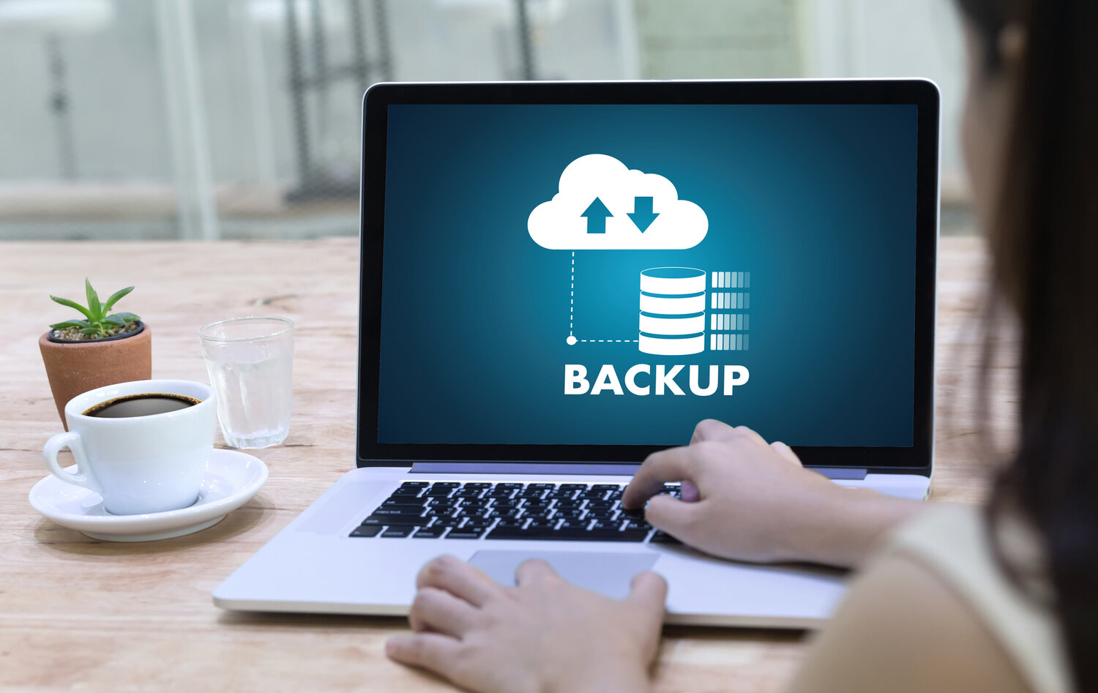
What are Backups and what is a Disaster Recovery (DR) environment?
- A DR is a secondary IT system that allows operations to transition seamlessly to an alternative setup with minimal downtime in the event of a cyberattack, hardware failure, or natural disaster. It ensures that critical systems remain available and functional when the primary system becomes unusable.
- A Backup is a creation of copies of important data , applications or systems typically stored in separate, secure locations to ensure that data can be restored when needed

Slide 5
The difference between a backup and a DR
Backup
Stores copies of data for recovery
Focuses on data(files and databases)
Can take hours
01
DR – Disaster Recovery
Enables rapid transition to an alterative system
Covers entire system
Designed for minimal downtime (minutes to hours)
02

Slide 6
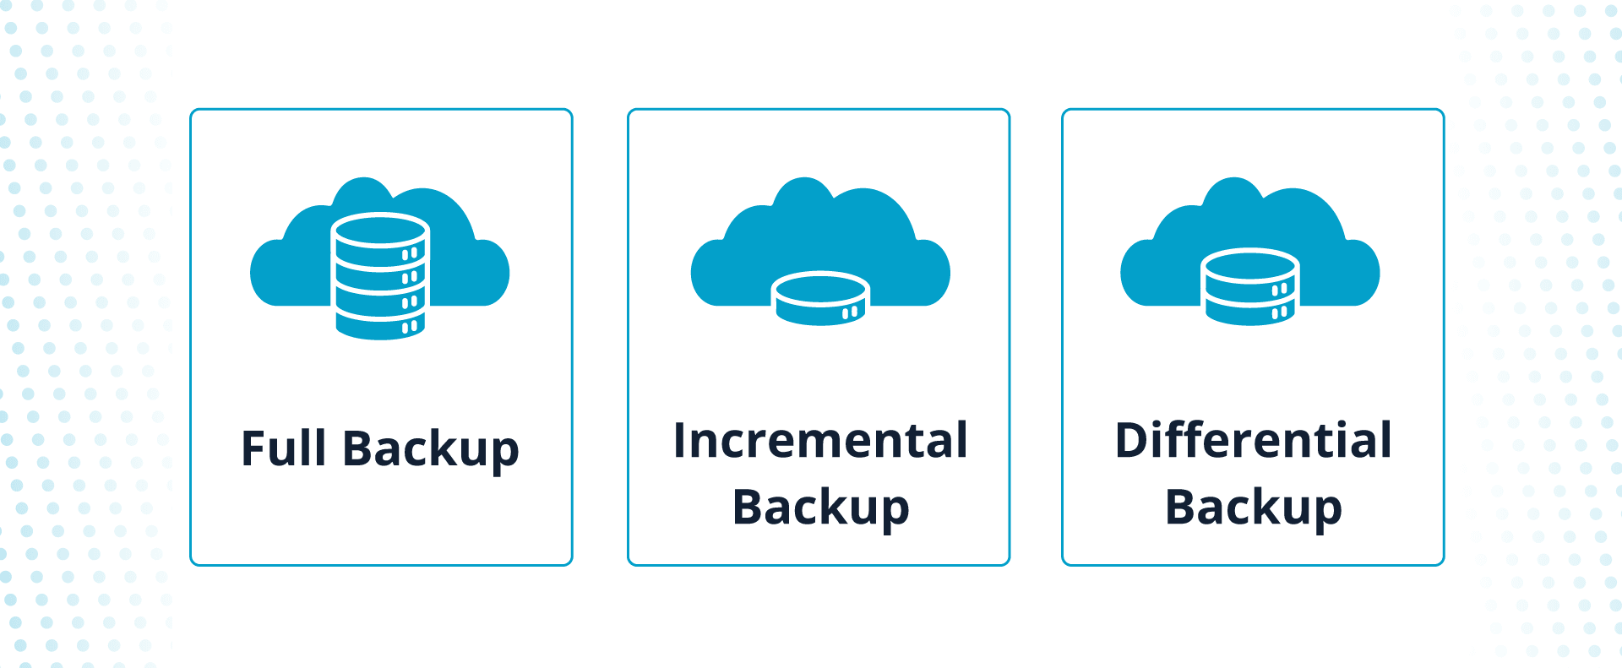
Types of backups

Slide 7
Importance of backups
1
Data Recovery
3
Regulatory Compliance
2
Business continuity
4
Peace of mind

Slide 8
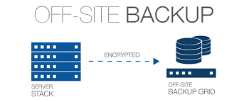
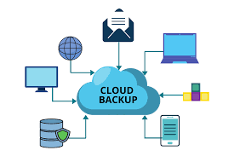
Backup Locations
Onsite
Offsite
Cloud

Slide 9
What are we protecting against
Cybersecurity Threats
Human error
Hardware Failure
Software Corruption

Slide 10
Backup Process Overview

Slide 11
Backup Process Overview
Source Backups are sourced from the mechanism that you choose to use, you can ither choose between an Export backup or an Rman backup
Destination
Backups are usually transferred offsite for many various reasons but the common been data protection , disaster recovery and security
Frequency
The frequency of a backup is determined by policy agreement , as that stipulates how often the backup are done and when they are transferred offsite
Automation It is ideal to automate the process of backups, automation can be done through services or through scripts

Slide 12
How Backups Are Created

Slide 13
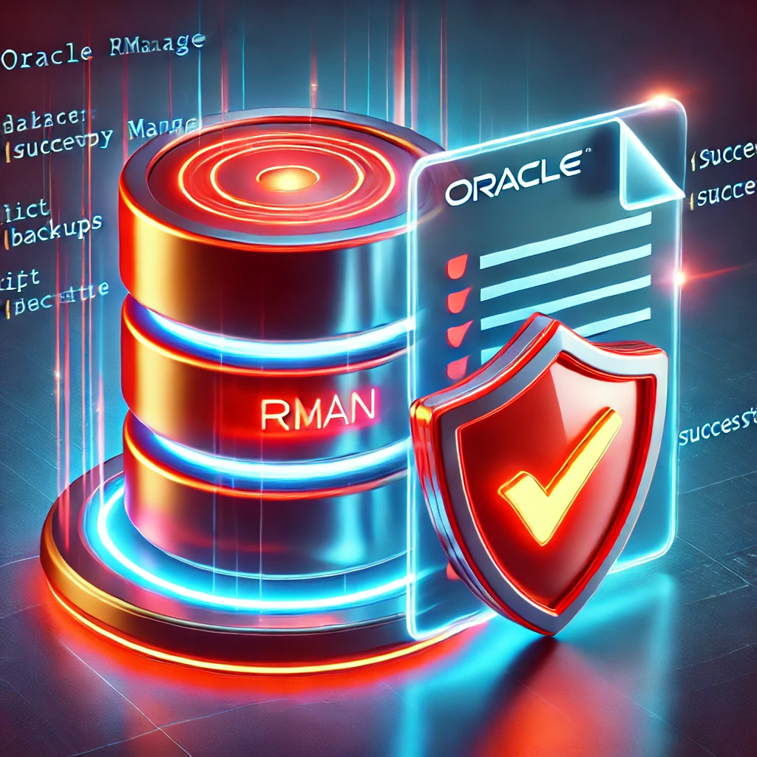
Creation of Backups
Backups are created by the mechanism you choose to use weather a Rman backup or an Export backup
Rman backup Oracle Recovery Manager (RMAN) is a backup and recovery tool built into Oracle databases that automatically takes snapshots of your data
Export backups
Refers to the process of using Oracle Data Pump to create logical backups of database objects and data
procedures

Slide 14
Inside Adapt IT Education Backup Strategy

Slide 15
Inside Adapt IT Education backup strategy
The Adapt IT Education division is transitioning into the cloud, as a result leading to the migration of many workloads to either fully cloud-based or hybrid environments.
Inside our backup strategy
01
The use of multiple scripts that have been designed uniquely for each of our clients
02
These scripts automate the creation of the backup and also initiate the process of transferring the backup offsite.
03
Scripts are dependent on a number of factors: The size of the Rman What type of Rman is run for the specific client
0
Disaster recovery
05
Logging and Monitoring

Slide 16
Inside Adapt IT Education Backup Strategy
-We have transitioned to Cloud-Based Backups through our strategic Partner AWS We chose AWS S3 as our cloud storage solution because when it comes to our “Use-Case” it offers the best balance of:
Performance
Reliability
Cost-effectiveness

Slide 17
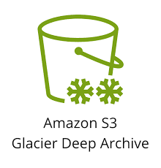
Inside Adapt IT Education backup strategy
Our use case is straightforward: We transfer our RMAN backup daily to S3. Since S3 provides multiple storage classes optimized for different needs, we have selected S3 Glacier Deep Archive as the most cost-effective option for long-term backup storage.

Slide 18
Process Flow Of How Cloud-Based Backups Are Done

Slide 19
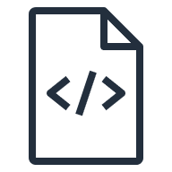
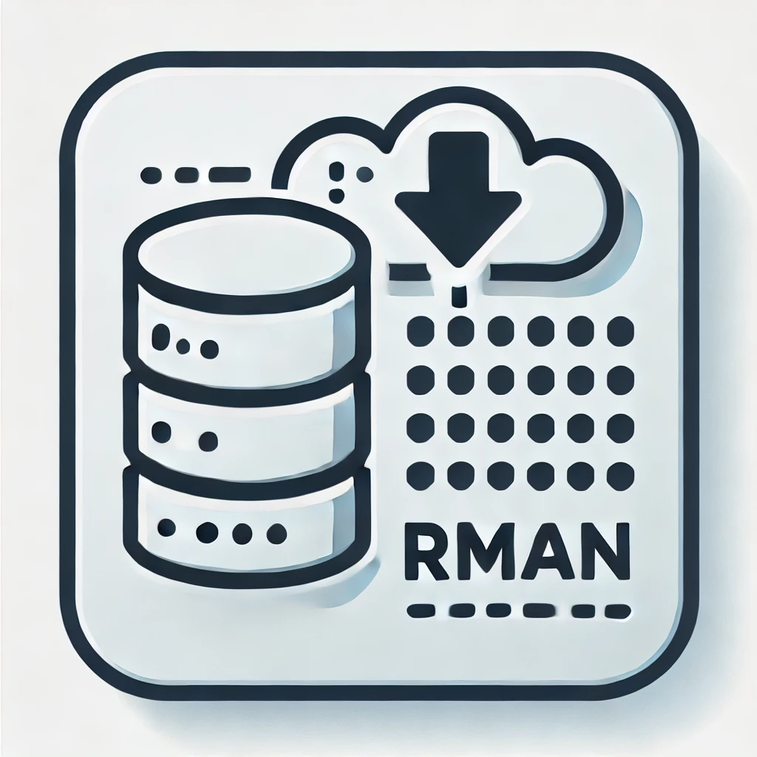
Process flow of how Cloud-Based Backups are done
On-Prem Data Center
Hosted Server
On-Prem Data Center
AWS Cloud
Export Backup
Data transitioning
to cold storage
Rman Backup
Script on server to send Rman to S3
Encrypted data in transit
S3 Standard
S3 Glacier Deep Archive
Rman /Export Backup Script
Creates the RMAN backup/Export Backup

Slide 20
Rman Backup Recovery Process Flow

Slide 21
Rman Backup recovery process flow
AWS Cloud
Data center
On-Prem Data Center
S3 Standard
Hosted server
Data transitioning
to hot storage
Encrypted Data in Transit
Restore and Recovery script
S3 Glacier Deep Archive
Restored Database

Slide 22
Retention Policy

Slide 23
Retention Policy
What is a retention Policy? Set of rules that determine how long a backup or data is kept, the rules compromise of:
01
02
03
04
Retention Period
Backup Frequency
Deletion Rules
Compliance Requirements

Slide 24
Conclusion
Backups are essential for any business, they are key when it come to business continuity during a crisis. It is also important to have a backup strategy as that helps with plaining and dictates the steps involved which lead to having a successful backup life cycle.
The type of backups and type of storage that is chosen is dependent on the business Use-Case and each use case is unique however it is important to choose the best type of storage that meets your needs you with your migration, so be sure to take advantage of them.

